Slide 1
13 Jun

Slide 2
Recap Last Meeting
Edges between clusters play significant role in error/accuracy
# of such edge depends on connection probability
pin and pout control the # of edges in/between blocks
=> come up with ideas:
 | pout | W
More relevance | Larger | Smaller
Less relevance | smaller | Larger

Slide 3
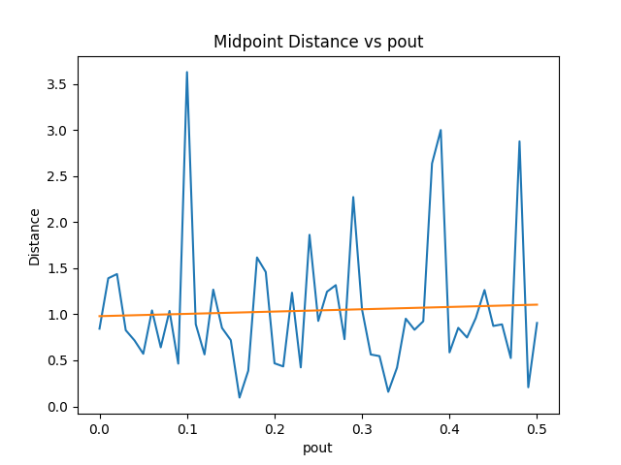
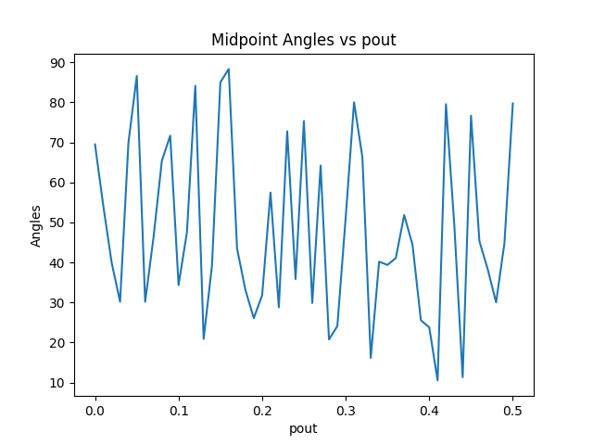
pout

Slide 4
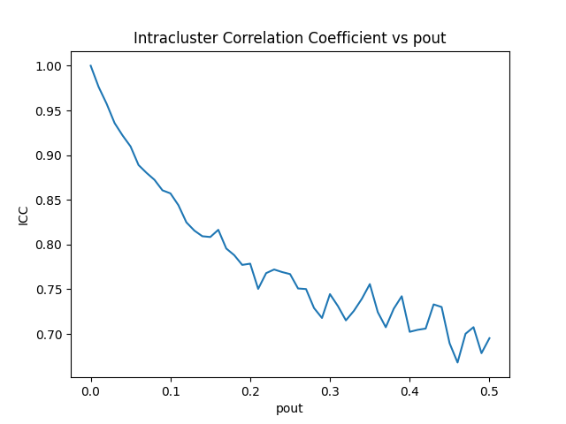
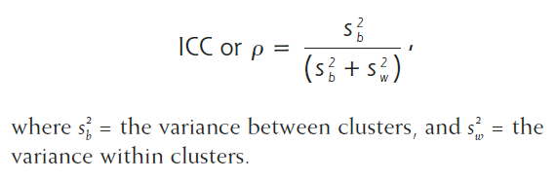
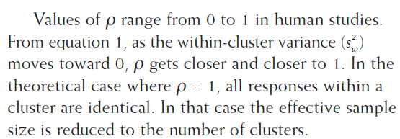
pout Intracluster Correlation Coefficient

Slide 5
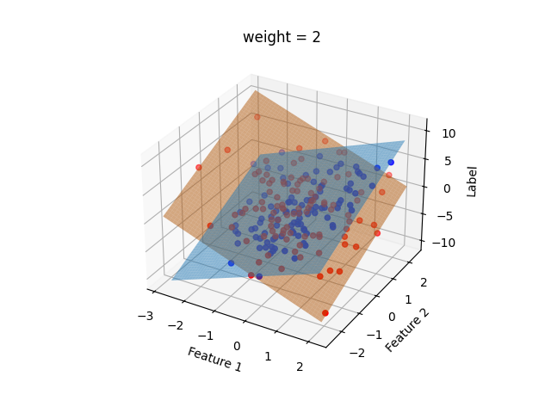
W
The graph is generated:
G = nx.stochastic_block_model(cluster_sizes, probs, seed=0)
W represents the weight for each edge in the SBM Graph.
It represents the importance of corresponding features.
For the method to generate labels:
label = np.dot(features, W[i]) + np.random.normal(0, noise_sd)
W works as a gradient.

Slide 6
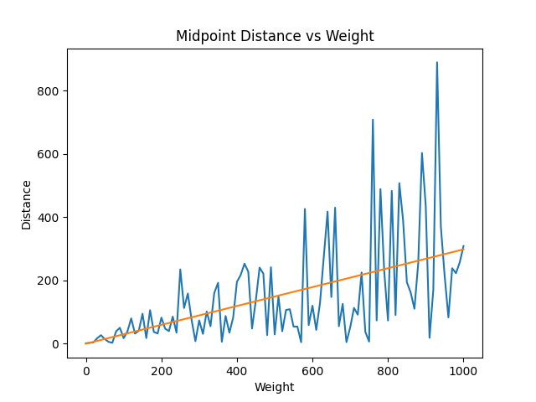
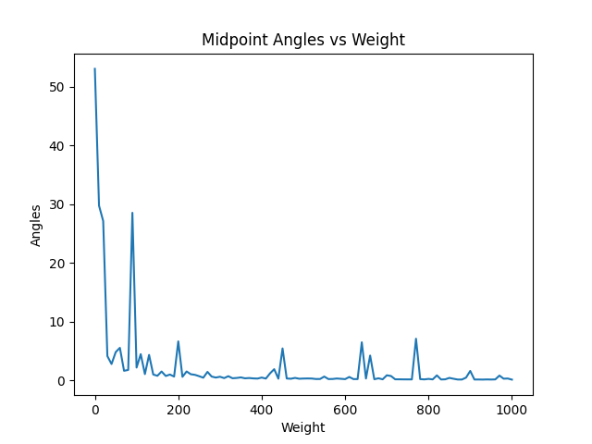
W = [±weight, 2] Midpoints of Hyperplane

Slide 7
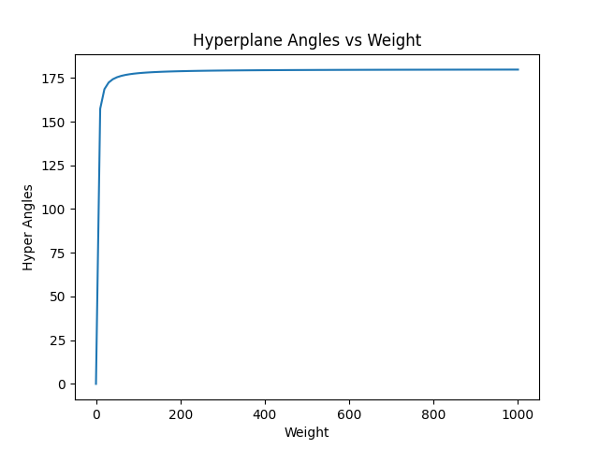
W = [±weight, 2] Angles between Hyperplane
Hyper Angles:
[0, 90): positive correlation
Correlation coefficient: (0, 1]
90: no correlation
Correlation coefficient: 0
(90, 180]: negative correlation
Correlation coefficient: [-1, 0)

Slide 8
Task Grouping in MTL
Identify Inter-Task Affinity between tasks:
Multi-task learning model training
First, all tasks are trained together in a multi-task learning model.
Calculate inter-task affinity
During the training process, the impact of each task's gradient update on the loss of other tasks is calculated and used as a proxy indicator of inter-task affinity.
Select a multitasking network
Based on the calculated affinity score, select a multitasking network that maximizes affinity.
Training task grouping model
Finally, the selected network is used for group training and deployed to the inference stage.

